Slide 1
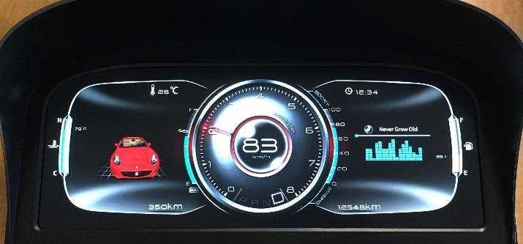
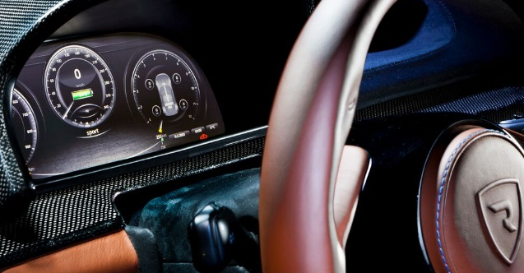
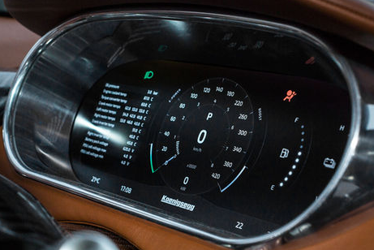
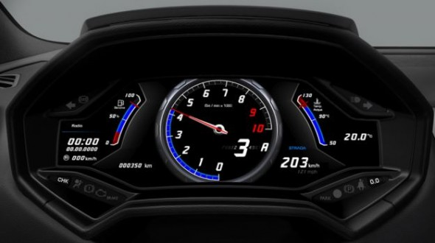
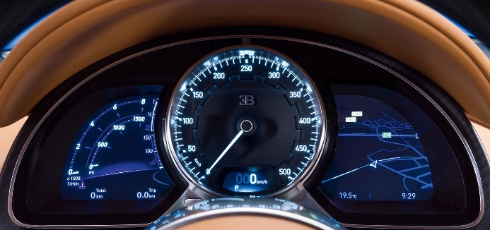
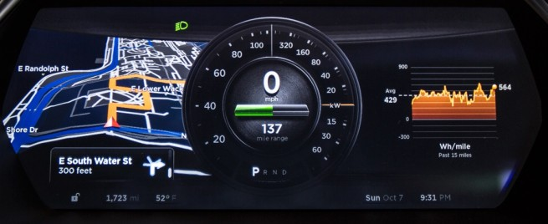
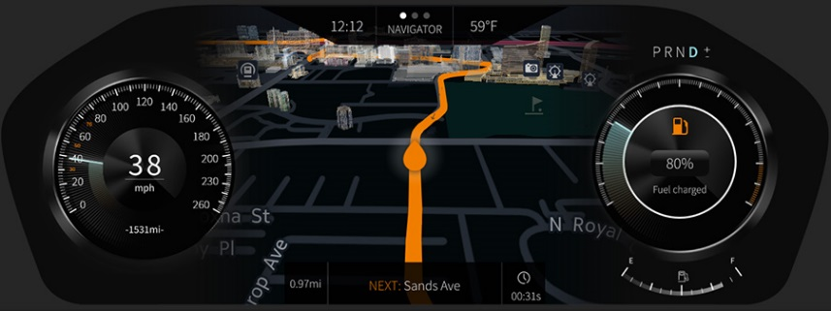
Qt For Instrument Clusters
Qt has a long history in Instrument Clusters
June 2017
Notes:
Pictures of all the Qt Instrument Cluster solutions in order to create the impression that Qt has a big history in the instrument cluster space. These would be:
AutoIO, Rimac, koenigsegg, Lamborghini
Bugatti, Tesla, Pelagicore/HERE/QtAS demo
Others?
Messaging: Qt has been used in creating instrument cluster UI for quite a long time. All these have been build using Qt. (Though non have been safety certified but safety certification is a relatively new thing)

Slide 2
Qt for Instrument Clusters
Qt has a long history in Instrument Clusters

Slide 3

Qt is the most agile technology for digital clusters
High performance driver experience in wide variety of SoCs
Visually impressing graphics (60 fps in both 2D and 3D)
Meets modern functional safety requirements
Allows combining content from Vehicle, IVI and Cloud
High quality tool chain for fast iterative development

Slide 4

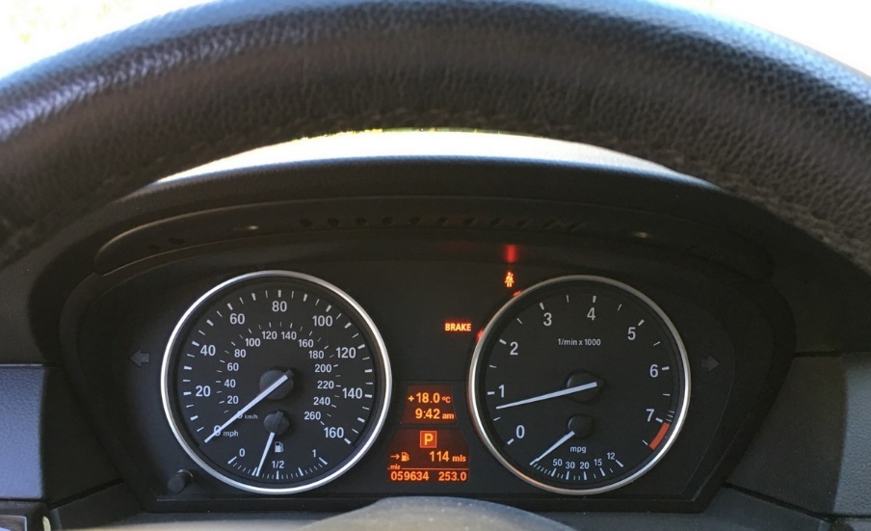
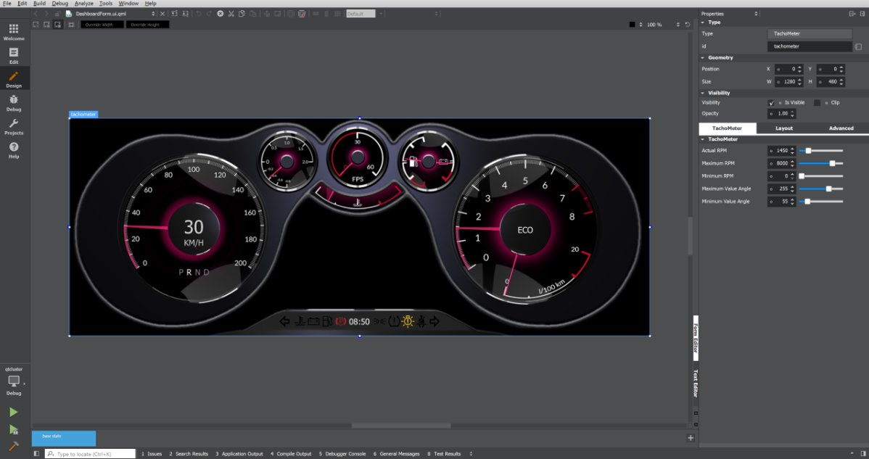

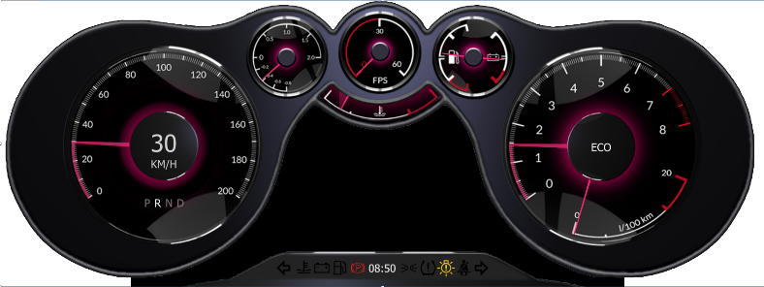
Building Instrument Clusters with Qt is now even faster
Usability & Performance Feedback
Rapid iteration to:
Find UX problems faster.
Evaluate different H/W price performance points.
Match UI ambition level to H/W performance.
Single click
deploy to hardware
Development Host
Qt 3D Studio and
Qt Quick Designer
WYSIWYG editing
Target Software
Qt Safe Renderer
ISO26262 ASIL-B Certified
Notes:
We’ve been working hard to make building instrument cluster UIs even faster and also with support to make it easy to support functional safety.
On the development side we’ve enhanced our Qt Quick Designer to make it easier to do drag and drop UI design.
We’ve added the Qt 3DE Studio for creating 3D UIs with key frames and timeline creation and editing.
Both these tools enable single click build and deploy to a target. This really simplifies deployment and testing on real hardware. This allows designers to test how their designs will perform on the target hardware, what it will look like on the actual LED display, are the graphics the right size. They can also try different hardware with different price/performance points to see what is needed to match the UI ambition.
We’ve created the Qt Safe Renderer to get a leg up with certifying systems for ISO26262 ASIL-B.

Slide 5
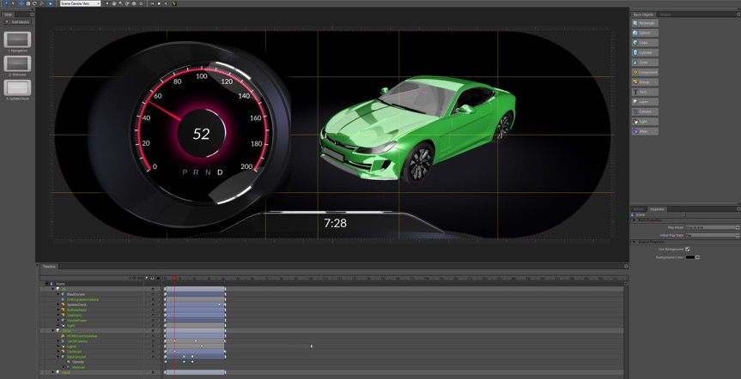
Qt 3D Studio
Takes Qt 3D UI tooling to a completely new level, allowing for rapid 3D UI creation and deployment.
WYSIWYG editing of the UI - Qt 3D Studio allows you to get there faster.
Qt integration – powerful 2D and 3D UI authoring technologies with all Qt goodies
Open architecture - extend to suite your needs
3D Asset import from popular design tools
Full control of materials, cameras and lighting, post processing effects
Used by all industries, not just automotive, creating large community of users
Notes:
This is just a one slider to explain that we have Qt 3D Studio. Assumption is that the full Qt3D Studio slide deck will be used for a deeper dive

Slide 6
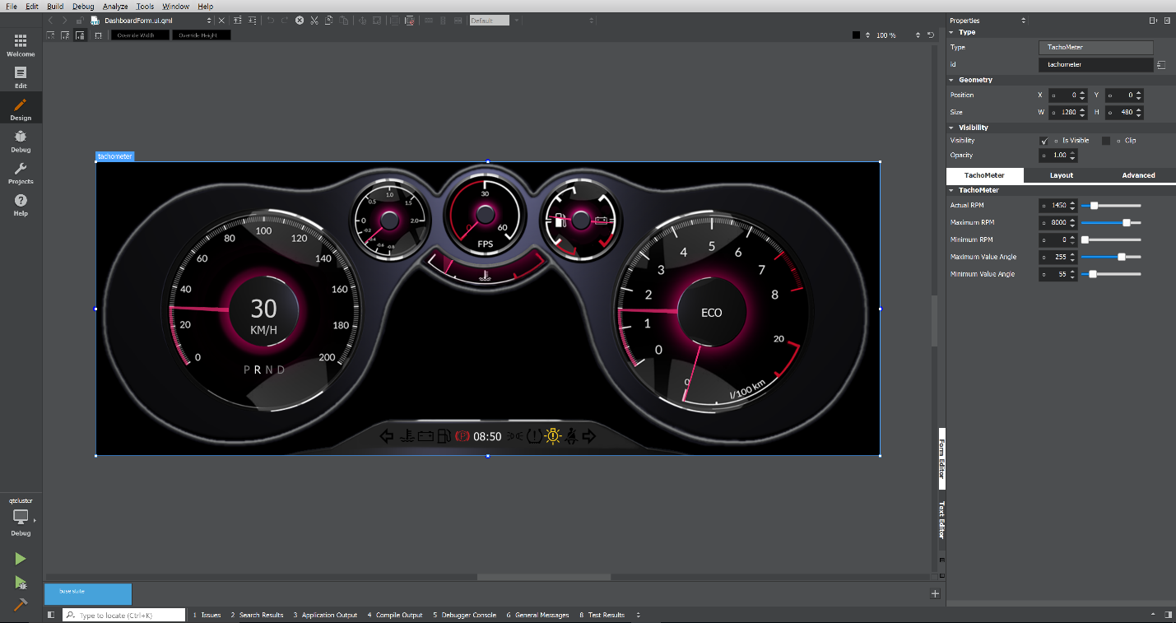
Qt Quick Designer for 2D
WYSIWYG drag and drop for 2D/2.5D UIs
Great for SoCs with low end GPUs, e.g. NXP i.MX6, Vybrid, i.MX7
Drag and Drop safety critical icons
Mark specific UI elements as safety critical
Full set of ISO standard icons included
Built into the Qt Creator IDE – one click deploy, debug and profile your application running on the target hardware
Instant feedback of performance on real hardware saving development time and costly mistakes in hardware sizing
Notes:
For situations where the hardware can’t do a lot of 3D, the Qt Quick Designer is a very good solution.

Slide 7
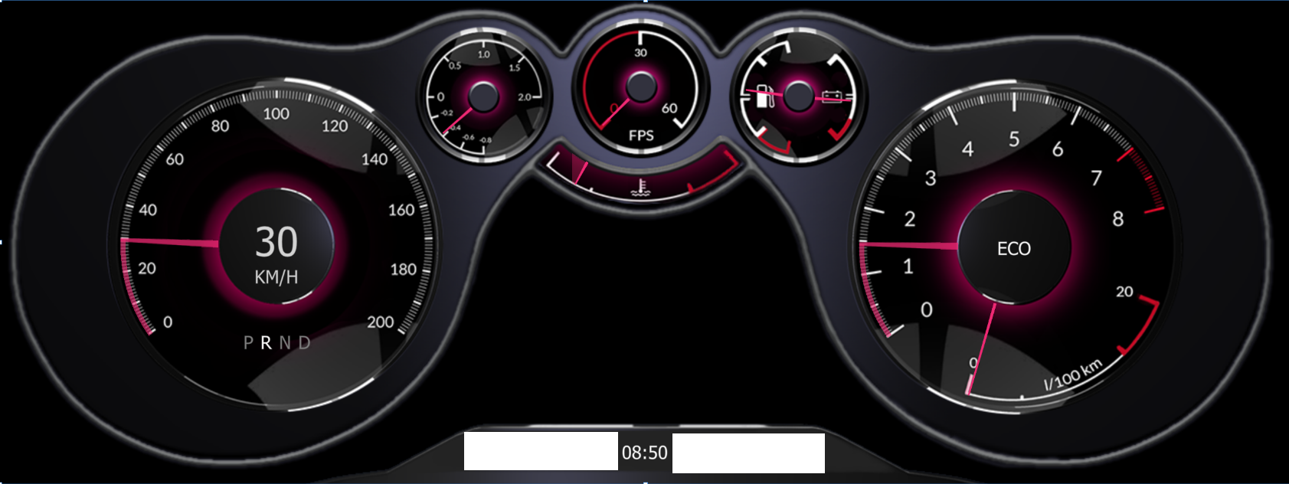

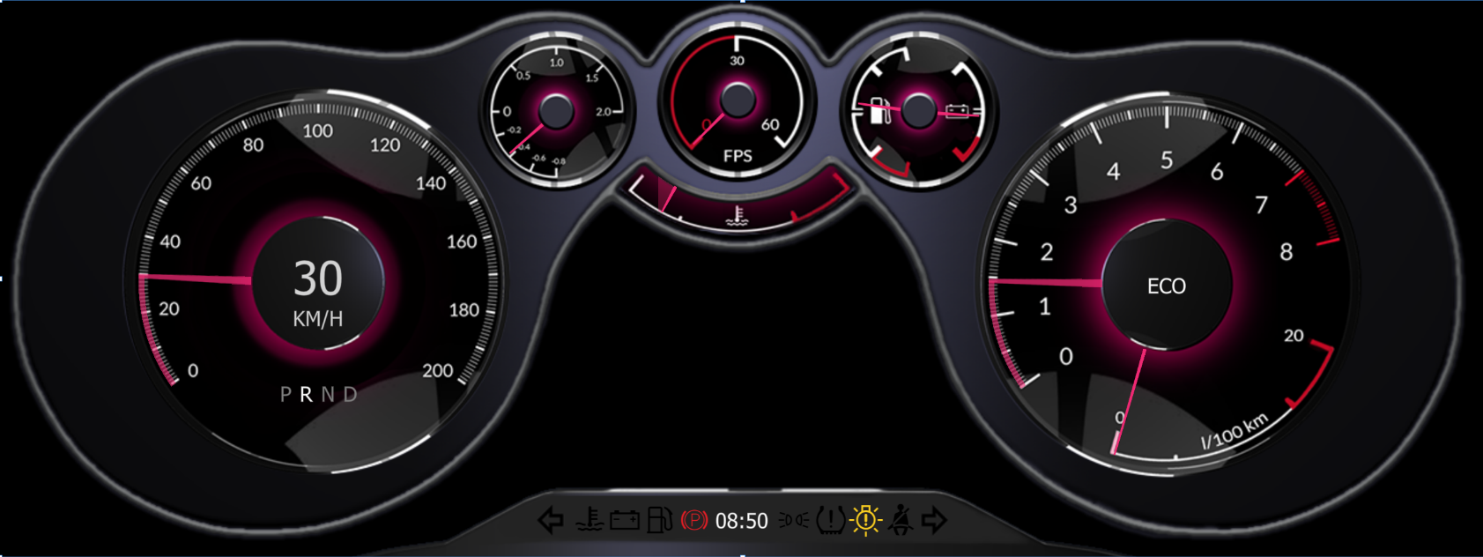
Qt Safe Renderer
ISO26262 ASIL-B Certified code
Faster and lower certification costs with reusable certification evidence
QNX and INTEGRITY support
Industry standard architecture
Rich UI
Cluster UI
ASIL-B
Safety critical graphics plane
Tell-tales
Safety critical UI
Qt
Qt Safe Renderer
UI design
Non safety critical graphics plane
Software Build
ASIL-D RTOS
Electronics
Notes:
Key points.
Start with one UI design.
Safety critical items are marked as such during the design process (see slide on Qt Quick Designer)
The build process splits the UI into two parts that are run in two domains:
1. Safety critical domain
2. Non-safety critical domain
Each domain is rendered to a separate graphics plane and hardware composition blends them together.
The bullet point “Industry Standard Architecture” reflect that this is the approach everyone in the industry is taking, even Kanzi. See text from their slide below:
Safety critical UI elements are tagged in Kanzi Studio. Two separate files are exported from Studio, one for regular UI and one for safety critical runtime.
•At runtime, Kanzi ISO26262 solution middleware is used for
loading and validating assets (e.g. warning symbols)
loading UI
rendering safety critical UI elements
validating rendering
•The Kanzi ISO26262 solution middleware is adapted to different OSs as they provide differing mechanisms for graphics safety.
•Safety critical UI pipeline is separated from regular UI by using the mechanisms provided by OS and target HW (different between OSs)
•User application is responsible for interfacing the system to retrieve information when safety critical elements should be drawn (e.g. toggle warning symbols on/off)

Slide 8
Qt Safe Renderer
Renders the safety critical UI
Controls hardware composition of the graphics planes
Monitors correct operation of the non-safety critical UI
Disables the non-safety UI if error detected in its operation
Will try to restart non-safety UI if failure detected
Notes:
The Qt Safe Rendered is our software component that runs in the safety critical domain.

Slide 9
Demo
https://www.youtube.com/watch?v=9RxxsOCeZHk

Slide 10
Supported Development Hosts, Target OS and SoCs
Development Hosts | Windows Linux
Target OS | QNX 6.5.1 - certified ASIL-D QNX 7.0 - planned certification by Q4 2017 INTEGRITY - certified ASIL-D Linux (needs to be certified by customer if used)
Supported SoCs | NVIDIA Tegra X1 NXP i.MX6 Renesas M3/H3 Intel Qualcomm 820
Available November 2017 with Qt 5.10
Target OS certifications provided by the OS vendor

Slide 11
Qt for Instrument Clusters with Low end Hardware
QtQuick technology is great for low end hardware
QtQuick has OpenGL, OpenVG and software renderer backends to support:
Hardware with no GPU
Hardware with only 2D graphics (e.g. OpenVG)
Hardware with low end GPUs
Examples: NXP i.MX6, Vybrid, i.MX7
Qt3D can be used for 3D effects in the instrument cluster, e.g. rotating car.
Video animations often used to reduce GPU load

Slide 12
Thank You

Slide 13
Educational Material
Instrument Clusters must be ISO 26262 ASIL B Certified System
Certifiable system with Qt requires:
Safety certified OS such as QNX or INTEGRITY
Safe renderer software - a small piece of code that can be certified as being correct
Hardware that supports 2 or more graphics layers

Slide 14
Why Do Instrument Clusters need to be Safety Certified?
Warning Lamps are ISO standard symbols that inform the driver of potentially hazardous situations
For example if the ABS is malfunctioning or the parking brake is on
If these fail to warn the driver there is a risk of loss of control of the vehicle
The old way is to measure the current through the LED
Early digital instrument clusters still used LEDs
Modern Instrument clusters display these on the LCD.
Lots of failure paths;
Faulty displays
Faulty drivers
Software bugs throughout the whole graphics pipeline

Slide 15
Can Qt itself be Certified?
Safety certification requires extensive documentation during development – this was never created for Qt
Qt coding conventions cover many safety aspects but not all
Standards recommend sub-setting of C++ but that would excluding vast parts of Qt
Use of dynamic objects prohibited, these are used extensively in Qt.
There is too much code to certify making certification prohibitively costly
What about QtLite?
QtLite is not a separate product, it is a way configuring Qt to exclude certain Qt features. It still has the same C++ features that are not allowed for certifiable code.
But a System with Qt can be Certified

Slide 16
Solution: Partitioning safety and non-safety domains
Standalone Instrument Cluster
Single SoC for both IVI and Instrument Cluster
IVI UI
Cluster UI
SC UI
Cluster UI
SC UI
Qt
SC
Logic
Qt
Qt
SC
Logic
RTOS Libraries
RTOS Libraries
OS / Linux
RTOS Kernel (SC)
RTOS Kernel (SC)
Type 1 Hypervisor (SC)
Electronics
Electronics
Non-filled “boxes” are signify safety certified components

Slide 17
Safety Critical Graphics
Cluster UI
ASIL-B
Tell-tales
Qt
Qt Safe Renderer
ASIL-D RTOS
Electronics
CANbus
Uses the multiple graphics planes that most SoCs support
Lower graphics layers for Qt which is used for the majority of the UI functionality
Top layer is for safety critical parts
Safety critical parts should be as simple as possible

Slide 18
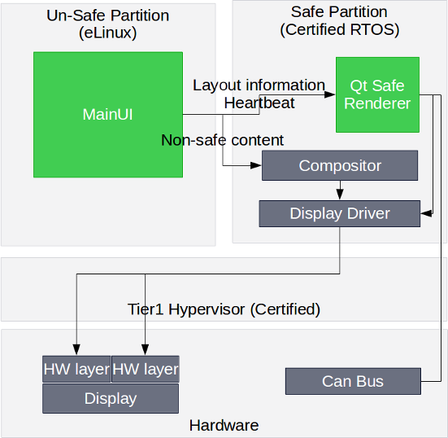
Qt Safe Renderer – Architecture
Qt Safe Renderer runs in the safe partition
Renders the safety critical graphics
Monitors the non-safe graphics
If error in non-safety critical graphics is detected then non-safe graphics plane is disabled, graphics process restarted.
Integration to Qt Quick Designer and Creator IDE
Integration to RTOS
QNX
INTEGRITY (planned)
Qt Safe Renderer controlled via CANbus messages during operations – no dependency to Main UI

Slide 19
Another way at looking at the reason for this architecture: Certified code is up to 100x more expensive!
Application Code
Graphics Libraries
OpenGL Stack
Fat software components. Many places for failure
OS e.g. Linux
Application Code
Graphics Drivers
ASIL-D RTOS
Thinner software components. Less code is easier to certify.
Graphics Drivers
Hardware
Hardware

Slide 20
Thank You

Slide 21
Product Packaging and Pricing
(proposed, internal only)

Slide 22
Qt Safe Renderer Product Packaging
Pre-requisites: Qt Device Creation or Qt Automotive Suite developer seat
Optional extra: Qt 3D Studio for high end 3D graphics creation
Qt Safe Renderer package containing:
Safe Renderer tooling
Safe Renderer code
Certification Statement
Service package

Slide 23
Product Pricing Proposal
Pricing
Program fee of $250K (SWAG) with a program defines as a production model.
Runtimes. Qt DC plus 25%
If Qt 3D Runtime is used the Qt DC 25% fee is also added
Notes
Program fee, say 6 digits, rather than a run-time, but allow to amortize over run-times if the customer wants to finance it that way.
Program fee needs to be balanced against the cost of the customer developing it themselves.
Our estimates are that it will cost us $0.5M to develop Qt Safe Renderer with ongoing annual costs of $0.???

Slide 24
Supported Hosts and Targets
External Communication – Deliberately vague about the full matrix of support as this will be customer driven.
Development Hosts | Windows, Linux
Target OS | QNX: 6.5.1, 7.0 (Q4 2017) are certified, INTEGRITY
Supported SoCs | Tegra X1, i.MX6, Renesas M3/H3, Intel, Qualcomm 820
Internal Communication – What we think the market needs but we’ll adapt as things change.
 | Tegra X1 | i.MX6 | Renesas M3/H3 | Intel | Qualcomm 820
QNX | yes | yes
INTEGRITY |  |  | yes | yes | yes

Slide 25
Timeline
 | May | June | July | August | September | October | November | December
Qt 3D Studio | Qt 3D Studio Early Access | Qt 3D Studio Early Access |  |  |  | Qt 3D Studio General Release
Qt Safe Renderer | Proof of concept on QNX |  |  | Package and pricing agreed | Safe Renderer complete for QNX | INTEGRITY support |  | Release with 5.10
Integrated Cockpit (IVI + IC) demos [1] |  |  |  | Linux & QNX (DriveCX) | Linux + INTEGRITY (H3, Intel) | Linux + INTEGRITY (QC) |  | Release with 5.10 and QtAS 2.0
Notes
Order of development of the Integrated cockpit demos subject to change due to dependencies on customer needs and level of support from silicon and RTOS vendors.

Slide 26
Competitive Analysis
Kanzi vs Qt

Slide 27
Ease of Use, Learning Curve
Qt 3D Studio is easier to learn than Kanzi – based on what we’ve heard from customers
Qt 3D Studio is intuitive for designers familiar with photoshop and Adobe Flash.
Steve Mendoza from NVIDIA (a game designer in his spare time) gave up in frustration trying to get things done in Kanzi.
NIO in Silicon Valley said their designer took 6 months to get fully competent with Kanzi.
Our technical artist with a gaming background took 2 weeks to become competent in Qt 3D Studio.
Rightware is solving their usability problem by signing up design studios to gain Kanzi expertise and provide design services, an acknowledgement that it is hard to learn to use and they need a new approach.

Slide 28
Developer Community
Customer’s we’ve spoken to talk complain about the small size of Kanzi community, hard to find people with Kanzi expertize
Qt3D Studio
While it is new, it is easy to learn.
Many in the industry has evaluated it as NDD and liked it but reject it as NVIDIA proprietary
Qt 3D Studio will available to all industries, not just automotive. It will be included as part of the Open Source package under GPL licensing with the goal of creating a large community of developers.

Slide 29
Performance
Qt demonstrated 250ms startup time on i.MX6 Quad.
Excludes OS boot time
Dependent on complexity of graphical assets
Performance talking points
Startup time dependent on CPU bus bandwidth, Flash memory speed and amount of graphical assets that need to be loaded at startup. It is a complex calculation.

Slide 30
Kanzi Advantage
Kanzi-lite
Boots 2D in 150ms on Cortex M7 class device. They may also support Cortex R5 class devices which are designed for safety critical applications.
To compete would require that we create an entirely new product to fit a typical MCU. Cypress creates a product: Cortex R4, 2MB Internal Flash, 208K internal RAM, 2D graphics engine. Qt is not even close to fitting into this.
Business case suggests this is not worth going after as we expect low cost i.MX6 capable devices to become cost competitive within 3 years.
History in the industry with many references

Slide 31
Qt Advantage
The Kanzi run-time is a black box. If something that doesn’t work out of the box then you need to call Kanzi. We provide source code, there are many service companies with Qt expertise.
If Kanzi doesn’t work on your hardware or OS then you need to pay NRE from HQ to get it to work.
The same technology can be used across the whole cockpit. This does resonate with many customers.
It means designers can be used for both instrument cluster and IVI. (Yes, many OEMs/Tier1s still have these as separate departments but this is changing)
It means engineering skill can be easily moved between instrument cluster and IVI. No need to train engineers on different toolkits.
Pricing savings when used for both Instrument Cluster and IVI
Developer seats can be used for both projects
Discounted run-time costs when Qt used in multiple systems in a car
Qt has a huge community of developers and is well know in many industries.

Slide 32
Kanzi vs. Qt (older slide)
 | Kanzi (Outside in) | Qt
Technology merits | Leading 2D and 3D UI design tool chain in cluster creation. Fast WYSIWYG designs | Design tools exist but creating a functional UI requires some coding
 | Dynamic content additions, based on user interaction | Rich libraries with functionalities (predefined)
 | No security ASIL / ISO 26262 certifications (based on partners’ insights) | No security certifications (most likely no needed for Qt, other architecture options available)
Scope | ”Fit for single purpose” architecture, low level drawing on OpenGL | Scalable architecture, high productivity (QML) + single SoC for Ivi + cluster
 | Small user base, limited 3rd party support | Large community (competence), 3rd party developers
 | Focused heavily on automotive and mainly instrument cluster | Horizontal offering, contribution and enablers from other industries
Business model / partnering | UI design tool oriented (no source code available) | Source code delivery
 | Public information almost non-existing | Everything (documentation, source etc.) available publicly
 | Start-up at the end of exit window | Publicly listed company with credible growth plan
 | Partnership program started, seems to have multiple companies. Audi as the key reference | Large silent partnership program, no visible (automotive) reference

Slide 33
Things to do
ISO26262 part 6 and part 8 + TCL (Tool Confidence Level) 2
Performance benchmarks – different CPUs, screen sizes
Discussion on multi-area animation

